Slide 1
NumPy & JAX NumPy: Numerical Computing with Python
Key Differences and JAX Superpowers
Notes:
Let’s compare the standard NumPy library, which I know most of you are very familiar with, to its counterpart in the JAX ecosystem, jax.numpy. Since you've got experience with NumPy and PyTorch, the goal here is to bridge the gap – showing you how jax.numpy leverages that familiar API but operates quite differently under the hood, and why those differences matter for high-performance computing, especially in machine learning. In this first part we’ll be focusing on the fundamental differences between NumPy and JAX, highlighting the performance gains and design principles that make JAX a compelling choice for high-performance computing.

Slide 2


Familiar API, Powerful New Engine
You know NumPy: The foundation of Python scientific computing (ndarray, rich function library).
You've seen JAX: High-performance numerical computing, especially for ML research.
jax.numpy is designed to feel like NumPy, but better.
NumPy, the NumPy logo and any related marks are trademarks of the NumPy project
Notes:
We all rely heavily on NumPy for numerical work in Python – its ndarray and functions are indispensable. Many of you also use PyTorch, appreciating its eager execution, autograd system, and GPU capabilities. JAX is emerging as a new major player, particularly strong in research and high-performance scenarios. The good news is that JAX provides jax.numpy specifically to make the transition easier. It mimics the NumPy API closely. But as we'll see, it's built on a fundamentally different engine. Our aim today is to unpack those key differences so you can confidently use JAX when its power is needed.

Slide 3
NumPy/PyTorch = Eager, JAX = JIT Compiled
NumPy/PyTorch (Default): Operations run immediately as Python encounters them. Easy debugging, intuitive flow.
JAX: Uses jax.jit for Just-In-Time compilation via XLA (Accelerated Linear Algebra).
Tracing: JAX traces the function once for given input shapes/types.
Optimization: XLA optimizes and compiles the traced operations into efficient kernels (often fused).
Execution: Subsequent calls with compatible inputs use the fast, compiled code.
Notes:
One major difference is how code executes. NumPy, and PyTorch by default, use eager execution. When Python sees np.add(a, b), that addition happens right then. It's straightforward and easy to debug line-by-line.
JAX takes a different approach, centered around Just-In-Time, or JIT, compilation using a powerful backend called XLA, which stands for Accelerated Linear Algebra. When you decorate a function with @jax.jit or call jax.jit(function), JAX doesn't run it immediately. Instead, it performs 'tracing'. It runs the function once with placeholder inputs representing the shapes and data types, recording all the JAX operations performed.
This recorded sequence is then handed off to XLA, which optimizes it heavily – fusing operations, managing memory efficiently – and compiles it down to highly optimized machine code, specific for your CPU, GPU, TPU, or other accelerator.

Slide 4
NumPy = Mutable, JAX = Immutable
NumPy: Arrays can be changed in-place. Standard Python behavior.
JAX: Arrays cannot be changed in-place. Returns a new array. Functional style.
# NumPy Example
import numpy as np
a_np = np.arange(4.)
print("Original:", a_np)
a_np[0] = 100.0 # Modify in-place
print("Modified:", a_np)
# Output:
# Original: [0. 1. 2. 3.]
# Modified: [100. 1. 2. 3.]
# JAX Example
import jax.numpy as jnp
a_jnp = jnp.arange(4.)
# a_jnp[0] = 100.0 # <-- This causes a TypeError!
# Use the .at[].set() syntax (or add, min, max...)
b_jnp = a_jnp.at[0].set(100.0) # New array
print(f'{a_jnp is b_jnp = }')
# Output:
# a_jnp is b_jnp = False
Notes:
Another difference is immutability. NumPy arrays, like Python lists, are mutable. You can change their elements directly, in-place, as shown in the NumPy example. a_np[0] = 100 modifies the original array.
JAX arrays, however, are immutable. Once created, you cannot change them. If you try the standard assignment like a_jnp[0] = 100, JAX will raise a TypeError. Why? This aligns with functional programming principles – functions shouldn't have side effects. This 'purity' is crucial for JAX's advanced transformations like automatic differentiation and compilation, which we'll discuss in a bit.
To update elements in JAX, you use an indexed update syntax: array.at[index].set(value). Notice that this doesn't change the original a_jnp; it returns a new array, b_jnp, with the modification. There are other methods besides .set(), like .add(), .min(), etc., for different update operations, but they all return new arrays.

Slide 5
Subtle Differences in Memory Handling
NumPy: Operations like transpose(), reshape(), slicing often return views (sharing underlying data).
Memory efficient, but changes through a view affect the original.
JAX: Equivalent operations typically return copies.
Consistent with immutability.
Seems less memory efficient? But: jax.jit() often optimizes away intermediate copies.
"buffer donation"
JAX approach eliminates lurking side-effects
Notes:
Related to immutability and execution is how JAX handles things that NumPy might return as 'views'. In NumPy, operations like reshaping or slicing often return a view, which is just a different way of looking at the same underlying data in memory. This is memory-efficient.
In JAX, these operations generally return copies of the data. This might seem less efficient initially, but it fits the immutable, functional model – operations produce new values. Crucially, the XLA compiler used by jax.jit is very good at optimizing these patterns. It can often eliminate unnecessary intermediate copies through techniques like 'buffer donation,' so the performance impact is often minimal in compiled code. The practical takeaway is you generally don't have to worry about accidental modification via views in JAX, and you can rely on JIT to handle the performance aspects. You may have run into cases where you have accidental modifications that lurk in your code and can be difficult to find and debug. The JAX approach eliminates those lurking side-effects.
(Speaker tip: Buffer donation is a memory optimization technique used by XLA (and exposed via JAX) where you explicitly allow the runtime system to reuse the memory buffer(s) allocated for certain input arguments of a function to store the output(s) of that function.)

Slide 6
Explicit PRNG Keys are Key!
NumPy: Uses a global random state. Easy to use, but tricky for reproducibility in complex/parallel code.
JAX: Requires explicit PRNG keys. Ensures reproducibility. Functional style.
# NumPy RNG
np.random.seed(0)
print(np.random.normal()) # Call 1
print(np.random.normal()) # Call 2
# Output:
# 1.764052345967664
# 0.4001572083672233
# JAX RNG
from jax import random
key = random.PRNGKey(0) # Initial key
print(random.normal(key))
print(random.normal(key))
# Output:
# 1.6226422
# 1.6226422
Notes:
NumPy relies on a global state for its random number generator. While convenient, this global state can lead to issues with reproducibility, especially in parallel or asynchronous computations.
In contrast, JAX utilizes explicit Pseudo-Random Number Generator (PRNG) keys to manage the state of its random number generators. A PRNG key is an explicit state that must be passed as an argument to JAX's random number generation functions. This explicit management of PRNG state ensures reproducibility, as the same initial key will always produce the same sequence of random numbers. This offers significant advantages in terms of clarity and reproducibility.
Note that to generate a sequence of independent random numbers, it is necessary to split the current key into a new key and a subkey using jax.random.split(), which is not shown in this example. The subkey is then used to generate the random numbers, while the new key becomes the state for subsequent random operations.

Slide 7
Write for One, Run for Many
NumPy: Relies on broadcasting and manually writing vectorized operations. Can be tricky for complex functions.
JAX: jax.vmap() automatically transforms a function written for single data points to operate over batches/axes.
NumPy, the NumPy logo and any related marks are trademarks of the NumPy project
Notes:
JAX offers a powerful function transformation called jax.vmap() that enables automatic vectorization of Python functions. Auto-vectorization is the process of automatically transforming a function that operates on single inputs to one that operates on batches of inputs efficiently. Instead of writing explicit loops to process multiple data points, users can apply jax.vmap() to their function, and JAX will automatically handle the batching logic, often leading to significant performance improvements. This is particularly useful in machine learning for processing mini-batches of data during training. While NumPy achieves vectorization through its array-based operations and broadcasting rules, jax.vmap() provides a more general and flexible mechanism to vectorize arbitrary Python functions, including those with complex internal logic.

Slide 8
Write for One, Run for Many
import jax
import jax.numpy as jnp
from jax import vmap
def predict(W, b, x):
return jnp.dot(W, x) + b
W = jnp.ones((3, 4))
b = jnp.ones(3)
batch_x = jnp.ones((10, 4)) # Batch of 10 data points
# Apply vmap() to predict the whole batch without a Python loop
batch_predict = vmap(predict, in_axes=(None, None, 0))
# Result is shape (10, 3) - one prediction per input in the batch
batch_result = batch_predict(W, b, batch_x)
Notes:
Here’s some example code showing how jax.vmap() is used to automatically vectorize arbitrary operations.

Slide 9
Pytrees
Tree-like nested Python containers (lists, tuples, dicts) holding JAX arrays (or other values) as "leaves"
Ubiquitous in JAX for parameters, metrics, optimizer states and etc.
Essential for initializing complex structures, applying updates, aggregating results
params = {
"layer1":{
"w":[1, 1],
"b":2
},
"layer2":{
"w":3,
"b":4
}
}
Notes:
Another key concept in JAX is pytrees. Understanding pytrees is fundamental to effectively using JAX, especially when working with models and their parameters.
A pytree is essentially a nested, tree-like data structure made from standard Python containers. Think dictionaries, lists, or tuples. The key idea is that these containers hold other containers or, ultimately, the actual data values, which we call the 'leaves'. Most often in JAX, these leaves will be JAX arrays, but they can technically be any Python object.
If you look at the code example on the right, params is a perfect illustration of a pytree. It's a dictionary. The keys 'layer1' and 'layer2' point to other dictionaries. Inside those, the keys 'w' (weights) and 'b' (biases) point to the leaves – in this case, a list representing a JAX array [1, 1] and scalar integers 2, 3, and 4. This nested structure is the pytree.
Why are pytrees important? Because pytrees are ubiquitous in the JAX ecosystem. You'll encounter them constantly. They are the standard way to handle collections of model parameters, as shown here, but also for things like training metrics, the internal states of optimizers, or even batches of data. They provide a natural and flexible way to group related arrays. This structure makes them essential for managing complex data.

Slide 10
Working with pytrees
params = {
"layer1":{
"w":[1, 1],
"b":2
},
"layer2":{
"w":3,
"b":4
}
}
jax.tree.map(lambda x: x*2, params)
# {'layer1': {'b': 4, 'w': [2, 2]}, 'layer2': {'b': 8, 'w': 6}}
Most JAX functions (jit, grad, vmap, optimizers) operate transparently over pytrees
jax.tree.map() works similarly to Python map(), but operates over pytrees
Notes:
Now let's look more specifically at how we interact with pytrees.
Pytrees seamlessly integrate with JAX's core transformations such as jit, vmap and grad. What this means is you can pass a whole pytree structure, like our params dictionary, into a function wrapped with jit or grad. JAX understands the structure. It will automatically apply the transformation to each leaf (each array or value) inside the pytree, and return a new pytree with the same structure but with the transformed leaves. You don't need to manually unpack the dictionary, apply the function to each array, and then repack it. JAX handles that complexity for you, which is incredibly convenient and powerful.
For custom operations, you can use jax.tree.map. Imagine wanting to convert all parameters in your model to a different data type, like bfloat16. You can do that with a single call to jax.tree.map over the entire model object.
You can think of jax.tree.map as being similar in spirit to Python's built-in map() function, but it's specifically designed to operate over nested pytree structures.
Let's look at the example code. We have our params pytree again. Suppose we want to double every single parameter value inside it. We can use jax.tree.map. The first argument is the function to apply – here, a simple lambda x: x*2 which takes a leaf x and returns its value multiplied by 2. The second argument is the pytree itself, params.
jax.tree.map then iterates through the entire params pytree. Every time it encounters a 'leaf' – like the list[1, 1] or the integers 2, 3, 4 – it applies our lambda function to that leaf. Critically, it then builds and returns a new pytree that has the exact same nested structure as the original params pytree, but where each leaf contains the result of applying the function.
You can see this in the output below the call. We still have the layer1/layer2 and w/b keys, but the values are now doubled: b in layer1 is 4, w is [2,2], b in layer2 is 8, and w is 6.

Slide 11
JAX Strength: Explicit Parallelism (shard_map)
aka “shmap”
Manual Control: Provides explicit, manual control over multi-device parallelism, complementing jit's automatic partitioning.
SPMD Approach: You write the code from a device-local perspective (Single-Program Multiple-Data).
Notes:
While JAX's jit() can automatically handle parallelism, sometimes you need finer-grained control. For this, JAX offers jax.shard_map(), aka “shmap”. Unlike jit's automatic approach, shard_map gives you explicit, manual control over how your computation is distributed. You define the computation from the perspective of a single device or shard and explicitly specify any communication needed between them using collective operations.

Slide 12
JAX Strength: Explicit Parallelism (shard_map)
aka “shmap”
Explicit Communication: Requires users to explicitly write collective communication operations (e.g., all_gather, psum) needed between devices/shards.
Expressive & Debuggable: Offers more expressiveness and can work eagerly, aiding debugging.
Notes:
shard_map is complementary to, and composable with, the automatic compiler-based parallelization built into jit(). With jit() you write code as if for a single device, and the compiler can automatically partition computation over multiple devices, generating per-device code and communication collectives behind the scenes. With shard_map you take control, writing your own partitioned code and explicit collectives. Or you can do a bit of both: take manual control across groups of devices while leaving within-group device partitioning up to the compiler. The two approaches can be mixed, matched, and composed as needed.
This approach offers more expressiveness and can be easier to debug, since it can run eagerly.

Slide 13
JAX Strength: shard_map() (aka “shmap”)
import jax
import jax.numpy as jnp
# jax.P is also a direct alias of PartitionSpec
from jax.sharding import Mesh, PartitionSpec as P
mesh = jax.make_mesh((8,), ('x',))
@jax.jit
def f_elementwise(x):
return 2 * jnp.sin(x) + 1
Notes:
To demonstrate how auto-parallelization works in JAX, let’s look at an example that uses a jax.jit()-decorated function. It’s a simple element-wise function, where the computation for each shard will be performed on the device associated with that shard, and the output is sharded in the same way.

Slide 14
JAX Strength: shard_map() (aka “shmap”)
f_elementwise_sharded = jax.shard_map(f_elementwise,# From previous
mesh=mesh, in_specs=P('x'), out_specs=P('x'))
arr = jnp.arange(32)
sharded = f_elementwise_sharded(arr)
sharded
Array([ 1. , 2.682942 , 2.818595 , 1.28224 , -0.513605 ,
-0.9178486 , 0.44116902, 2.3139732 , 2.9787164 , 1.824237 ,
-0.08804226, -0.99998045, -0.07314587, 1.840334 , 2.9812148 ,
2.3005757 , 0.42419338, -0.92279494, -0.50197446, 1.2997544 ,
2.8258905 , 2.6733112 , 0.98229736, -0.69244087, -0.81115675,
0.7352965 , 2.525117 , 2.912752 , 1.5418116 , -0.32726777,
-0.97606325, 0.19192469], dtype=float32)
Notes:
With jax.shard_map() you write a function that handles a single shard of data, and shard_map will construct the full function. The in_specs argument determines the shard sizes. The out_specs argument identifies how the blocks are assembled back together.

Slide 15

JAX Strength: shard_map() (aka “shmap”)
jax.debug.visualize_array_sharding(sharded)
Notes:
We can then visualize the array sharding with jax.debug.visualize_array_sharding(sharded)

Slide 16
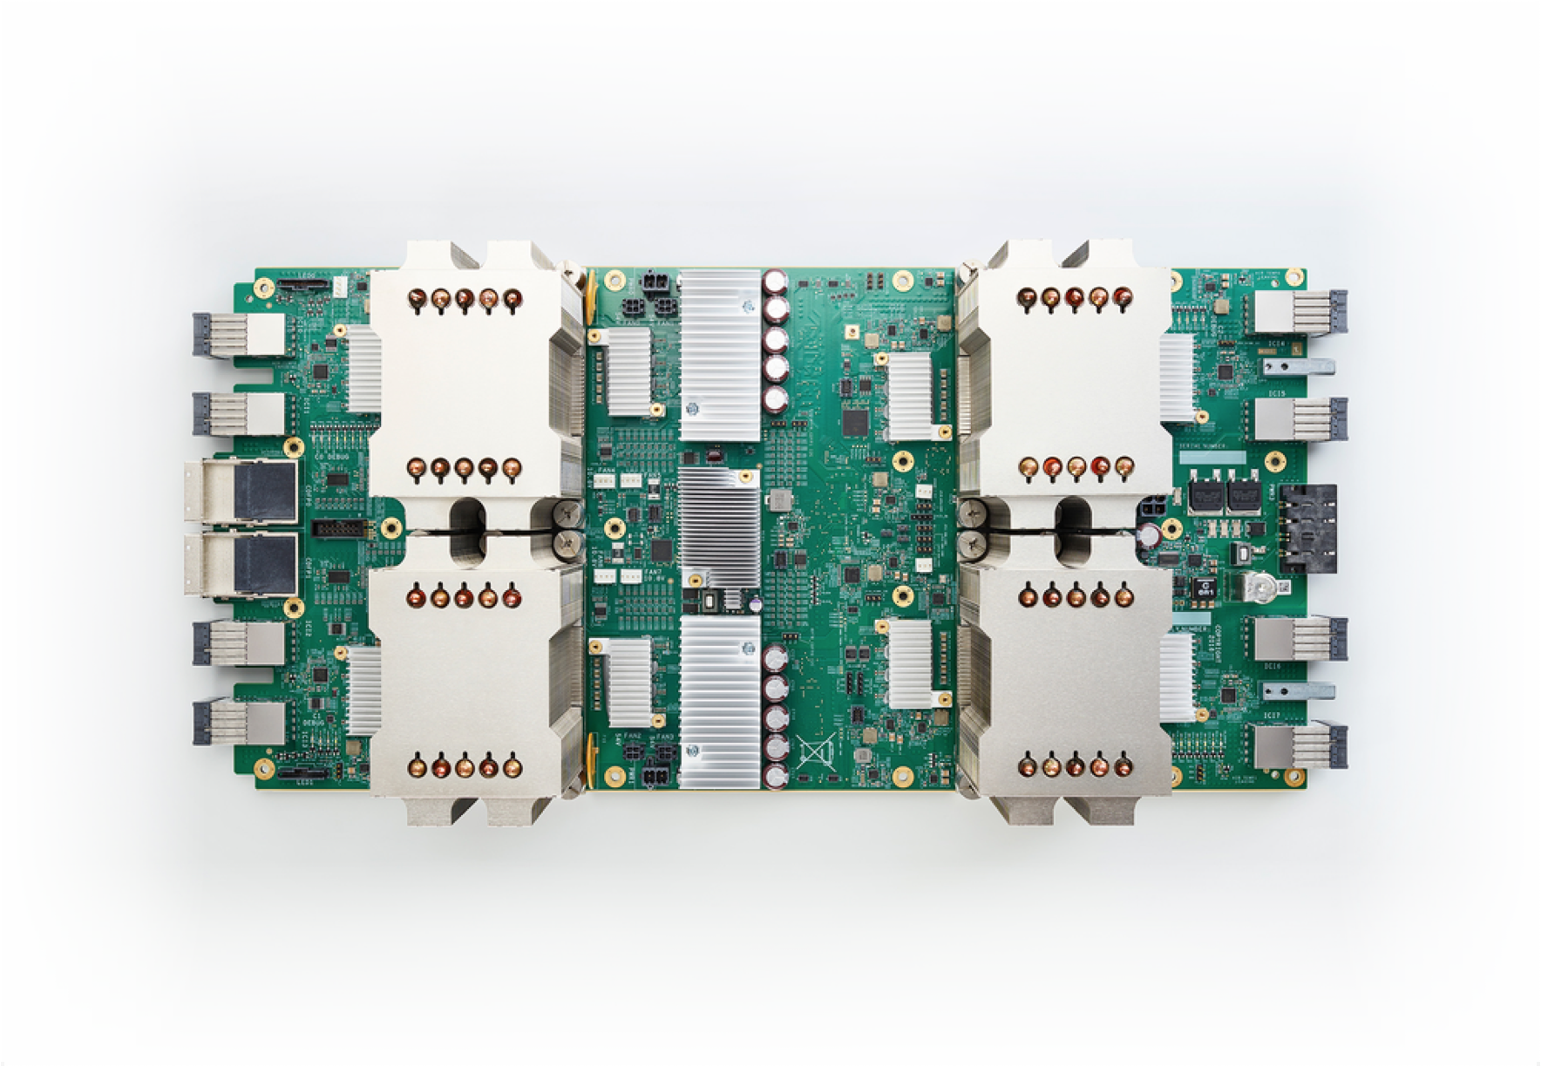
CPU, GPU, TPU - Write Once, Run Anywhere (Fast!)
NumPy: Primarily CPU-bound. GPU/TPU require other libraries (CuPy, Numba, etc.) often with code changes.
JAX: Built on XLA. Runs seamlessly on GPUs and TPUs without changing your jax.numpy code.
JAX detects available hardware.
jax.jit() compiles code optimized for the specific accelerator.
Benefit: Massive speedups for large-scale computation (deep learning, physics simulations) with minimal effort. Just run your script on a machine with the hardware!
Notes:
JAX is designed to run seamlessly on a variety of hardware platforms, including CPUs, GPUs, and TPUs, without requiring any changes to the user's code. This cross-platform compatibility is facilitated by JAX's reliance on the XLA compiler, which can generate optimized machine code tailored to a specific hardware backend. This ability to leverage the computational power of specialized hardware like GPUs and TPUs provides a significant performance advantage for computationally intensive numerical tasks, especially in the domain of machine learning. NumPy, while highly optimized for CPU execution, typically requires additional libraries or specific configurations to effectively utilize GPUs or TPUs. JAX's inherent support for hardware acceleration makes it a preferred choice for applications where performance is critical and access to specialized hardware is available.

Slide 17
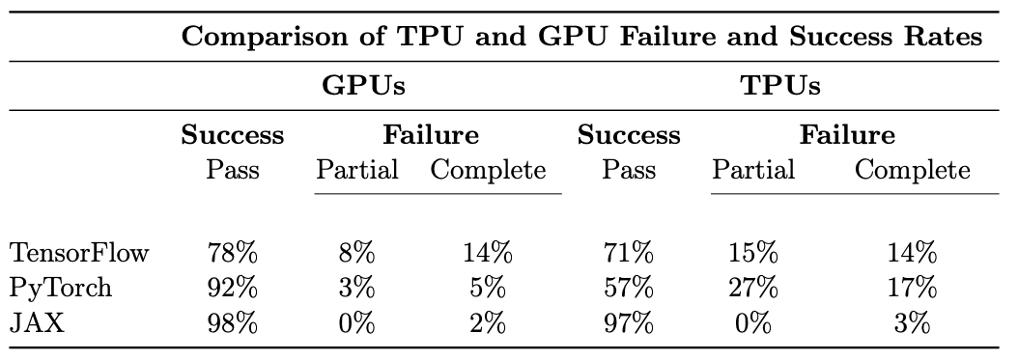
Hardware Portability: JAX v PyTorch v TF Failure Rates
Source: The Grand Illusion: The Myth of Software Portability and Implications for ML Progress (Cohere/MIT Sept 2023)
Notes:
Portability across accelerators can be important for a number of reasons, including the ability to train on one set of hardware and run inference on different hardware, with minimal code changes if any. This is common for example in autonomous vehicle applications, where onboard hardware is limited.
A 2023 study by Cohere and MIT demonstrated the benefits of XLA in terms of hardware portability. As you can see, their study demonstrated that JAX had the highest success rates and lowest failure rates across both GPUs and TPUs.

Slide 18
Key Differences at a Glance
Feature | NumPy | JAX NumPy | Why It Matters
Mutability | Mutable (in-place) | Immutable | Functional style, JAX transforms
Execution | Eager | JIT Compiled (via XLA) | Performance (esp. accelerators)
In-place Ops | a[i] = x | a.at[i].set(x) (new array) | Immutability requirement
Views/Copies | Often Views | Typically Copies | JIT optimizes copies away
RNG | Global State (np.random) | Explicit Keys (jax.random) | Reproducibility, parallelism
Autodiff (grad) | External Libs | Built-in (jax.grad) | Foundational for ML
Auto-vectorize (vmap) | Manual / Broadcasting | Built-in (jax.vmap) | Easier batching
Hardware | CPU (mostly) | CPU, GPU, TPU | Performance scaling
Notes:
Here’s a handy table showing the key differences between NumPy and JAX NumPy that we’ve just discussed.

Slide 19

Learning Resources
Code Exercises, Quick References, and Slides
https://goo.gle/learning-jax
More videos for learning JAX
https://goo.gle/learn-jax-videos
Notes:
You can learn more about JAX and the entire JAX AI Stack with these coding exercises, quick reference docs, and slides. To watch the whole Learning JAX series check out our playlist on YouTube!

Slide 20
Community and Docs
Community:
https://goo.gle/jax-community
Docs
JAX AI Stack: https://jaxstack.ai
JAX: https://jax.dev
Flax NNX: https://flax.readthedocs.io
Notes:
There’s a growing community on Discord for JAX, here’s an invite link, and here are links to the docs for JAX, Flax, and the JAX AI Stack. There’s much more coming in our upcoming episodes on the rest of the JAX AI Stack, so stay tuned, and don’t forget to hit like and subscribe. See you soon!

